Slide 1
Working With Git -1

Slide 2
Communication with Remote Repository
For authorized communication between remote repository and local repository, it’s required to add public key of local computer/machine to remote server.
For this we need to generate public key
We can generate such key using command from command prompt
ssh-keygen
and enter our desired name with it, once prompt to enter, we can enter passphrase as it’s optional, for more security

Slide 3
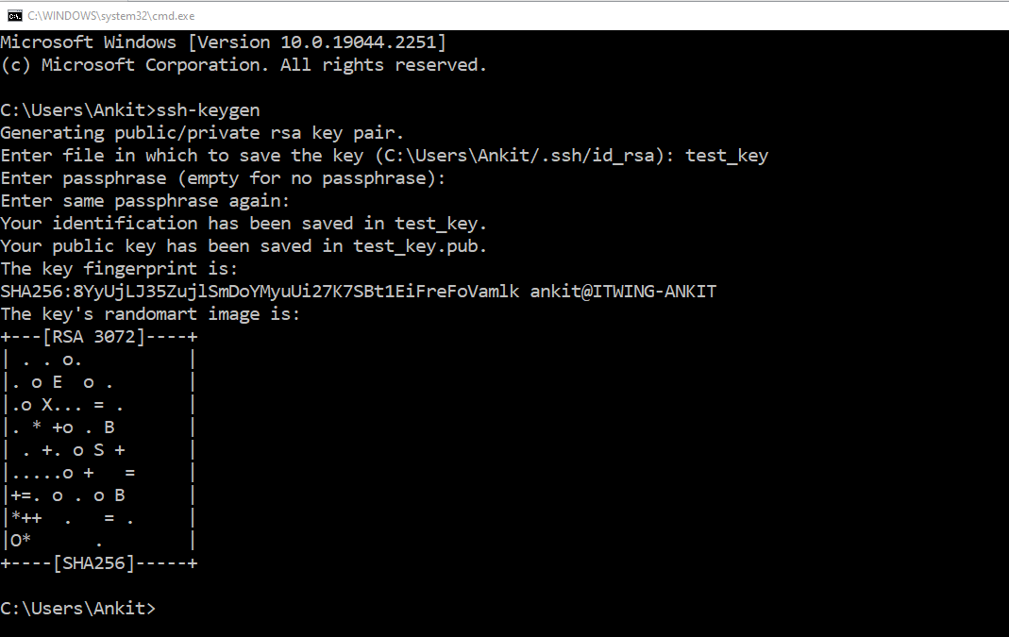
Once run command

Slide 4
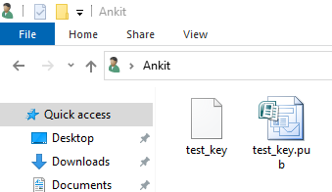
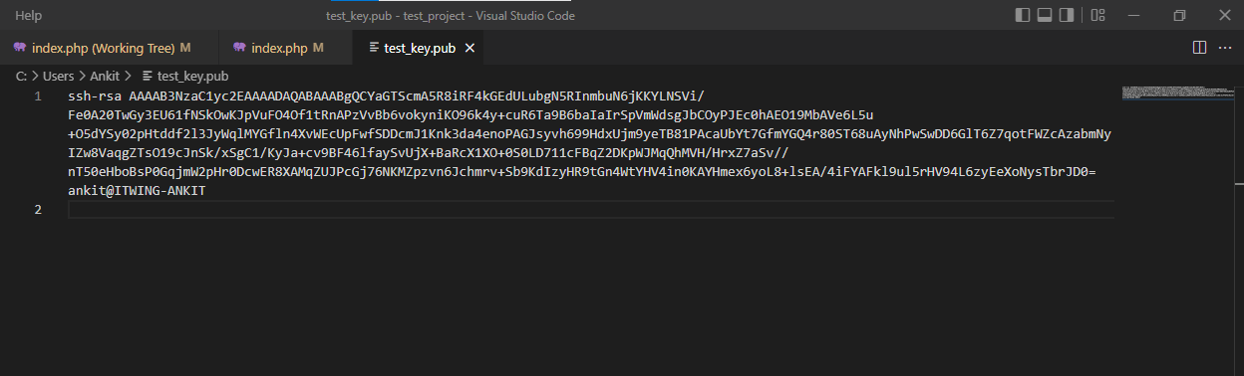
These keys would generates
We will open file with extension .pub with a text editor and copy it’s content

Slide 5
Depend upon git repository host, there will be need to add in “SSH Keys” under git repository owner’s profile.
For example in github.com, in github user’s profile section there is option to add SSH-key and GPG keys under settings option.

Slide 6
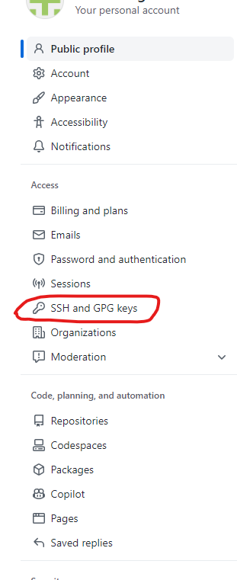
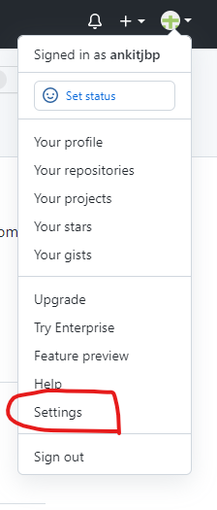

Slide 7
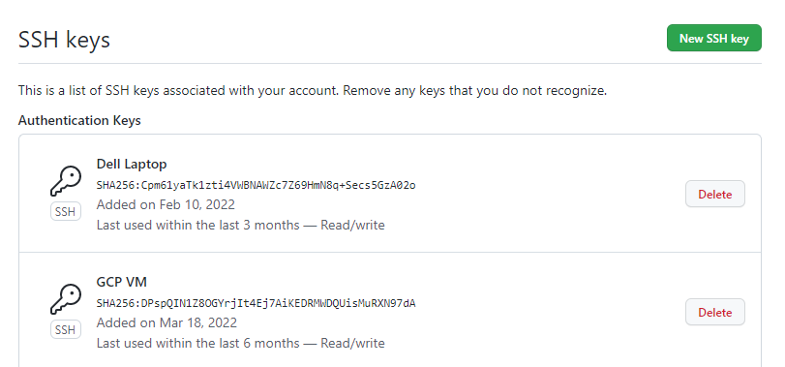

Slide 8
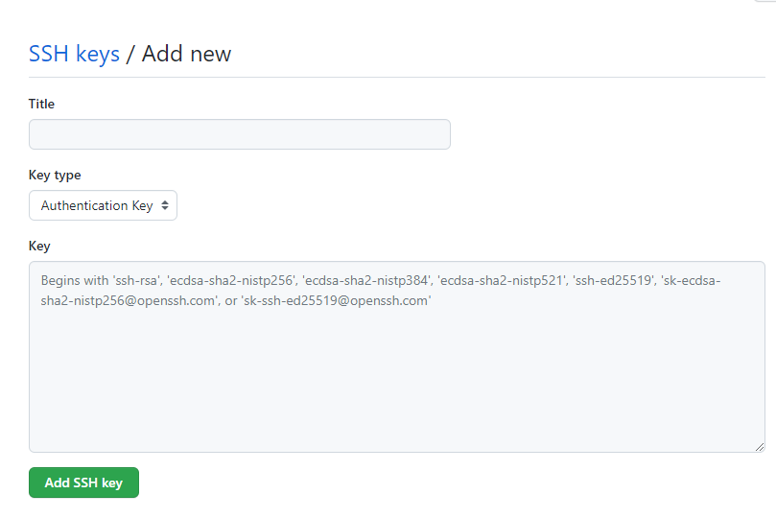
Add Title of key , paste content, copied from .pub file in “Key” Section. And Click on Add SSH Key Button

Slide 9
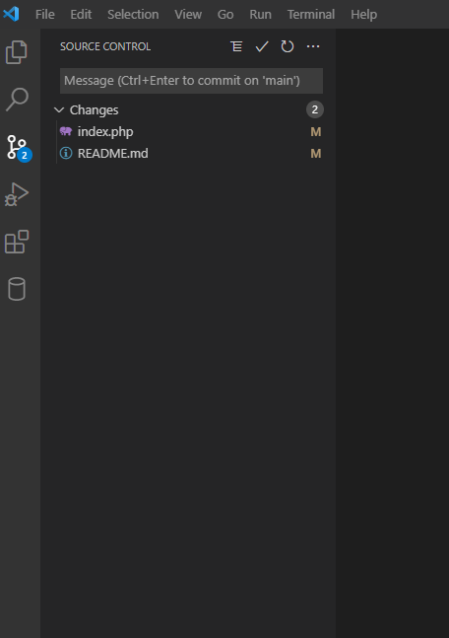
GUI of git with Microsoft Visual Code
There is an extension can be install in IDEs like Microsoft Code/ Netbeans to work on git

Slide 10
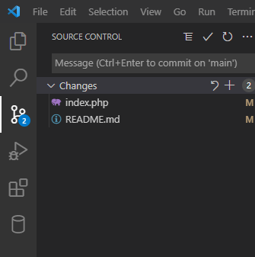
Example to use
Changes made in files will be shown under git panel

Slide 11
General issues during work on git
Un-stage files/directories from Index
Edit the last committed message
Forgot some changes in the last commit
Discard local changes
Committed personal data to the local repository
Replaced the latest commit with a new commit
Committed the wrong data
Get back to my old project state
Recover a deleted local branch
Undo changes done in a commit
Gave a wrong name to my branch
Want to re-arrange history logs before pushing to remote
Committed unrelated changes into a single commit
Change author-email in all commits on all branches
Lost and found files
Forgot which branch has my commit-id
Delete a commit from history
Pushed a wrong branch to the remote

Slide 12
Policies to use Git
Internal Polices are helpful required to get maximum benefit of it for the organization
Some of good practices are as follows.
For each module/new function work should be assign by Team Lead
To work on common file must have rule to keep work in separate branch
3) For integration, one point of contact should in touch with team for final deployment
4) Deployment policies should be followed for each level of deployment i.e testing, staging and production

